Slide 1
Software Requirement Engineering Software Engineering Department Spring 2025
Muhammad Huzaifa Shah

Slide 2
Week Agenda
Introduction to Process Models
Traditional vs. Agile Requirements Engineering
Documenting Requirements
Quality Measurement in Requirements Engineering
Activity & Case Study

Slide 3
2.2. User Stories
A simple, informal way to capture system functionalities from the user's perspective. Commonly used in Agile development to describe features concisely.
Structure of a User Story
Format: "As a [user role], I want to [feature] so that [benefit]."
Example: "As a customer, I want to reset my password so that I can regain account access."

Slide 4
Characteristics of Good User Stories (INVEST Model)
Independent: Should be self-contained and not dependent on others.
Negotiable: Can be refined based on team discussions.
Valuable: Provides value to the user.
Estimable: Can be estimated in terms of effort required.
Small: Should be completed within one development iteration.
Testable: Can be validated through acceptance criteria.

Slide 5
Example of User Story for an Online Banking System (1/2)
Title: Fund Transfer Between Accounts
Description:
"As a user, I want to transfer money between my accounts so that I can manage my finances efficiently."
Acceptance Criteria:
User can select source and destination accounts.
User can enter the transfer amount.
System verifies available balance before proceeding.
Transaction confirmation message is displayed.

Slide 6
Example of User Story for an Online Banking System (2/2)
Use Case Diagrams: Graphical representation of user interactions with the system.
User Stories: Simple descriptions of a feature from an end-user perspective, used in Agile projects.

Slide 7
3. Functional & Non-Functional Requirements (1/2)
Functional Requirements
“Define what the system must do”
Example: "The system shall allow users to log in using a username & password."
Non-Functional Requirements
“Define system quality attributes such as performance, security, and usability”
Example: "The system must handle 1000 concurrent users with <2s response time."

Slide 8
3. Functional & Non-Functional Requirements (2/2)
Real-Life Example:
Online Shopping Website:
Functional requirements include product search, checkout, and order tracking, while
Non-functional requirements cover security, speed, and reliability.

Slide 9
Viewpoints of Requirement Documentations (1/3)
SRS (Software Requirements Specification) is a comprehensive document that includes various elements like Functional & Non-Functional Requirements, Use Cases, and System Models.
These are all sections within an SRS, but they can also be documented separately depending on the project needs.

Slide 10
Viewpoints of Requirement Documentations (2/3)
Types of Requirement Documents can be viewed in two ways:
Independent Documents: If the project follows Agile, Use Cases, User Stories, Functional & Non-Functional Requirements, and Traceability Matrices might be maintained as separate lightweight documents.
Structured SRS Approach: In more traditional or regulated environments, all these elements might be combined within the SRS as different sections.

Slide 11
Viewpoints of Requirement Documentations (3/3)
SRS is a high-level document that integrates multiple requirement elements.
Functional & Non-Functional Requirements, Use Cases, and Traceability Matrices can either exist inside the SRS or as separate documents, depending on the project methodology.

Slide 12
Regression Testing (1/3)
Regression testing is a software testing technique that ensures that a program works as expected after changes to the code. Done by Quality Assurance (QA) Team.
It is used to verify that updates and fixes don't negatively affect existing features.

Slide 13
Regression Testing (2/3)
Every QA team needs to understand a client’s requirements and ensure to launch a defect-free application into the market.
To achieve this goal, the QA team should be aware of the end-to-end requirements & should draft the test plan covering all the functionalities/requirements.
QA team needs to split the software requirements provided by the client into multiple scenarios and then test cases.
With regression testing, each of the test cases has to be tested separately, covering all the dependent requirements as well.

Slide 14
Regression Testing (3/3)
A question arises here on how the QA team ensures that all possible scenarios/cases are covered in the test plan?
How do we ensure that all the requirements are covered in the testing cycle?
A simple & easy solution is to map the requirement with related test scenarios and respective test cases, this map can be called a ‘Requirement Traceability Matrix (RTM)’

Slide 15
4. Traceability Matrix (1/3)
A Requirement Traceability Matrix (RTM) also known as Traceability Matrix is a document that maps and tracks the relationship between requirements, design, implementation, and testing.
It ensures that every requirement is properly implemented and validated.
Commonly used in projects where compliance and completeness are critical.

Slide 16
4. Traceability Matrix (2/3)
RTM maps all the requirements with the test cases.
By using RTM (document) one can verify test cases cover all functionality of the application as per the requirements of the customer.
Requirements: Requirements of a particular project from the client.
Traceability: The ability to trace the tests.
Matrix: The data which can be stored in rows and columns form.

Slide 17
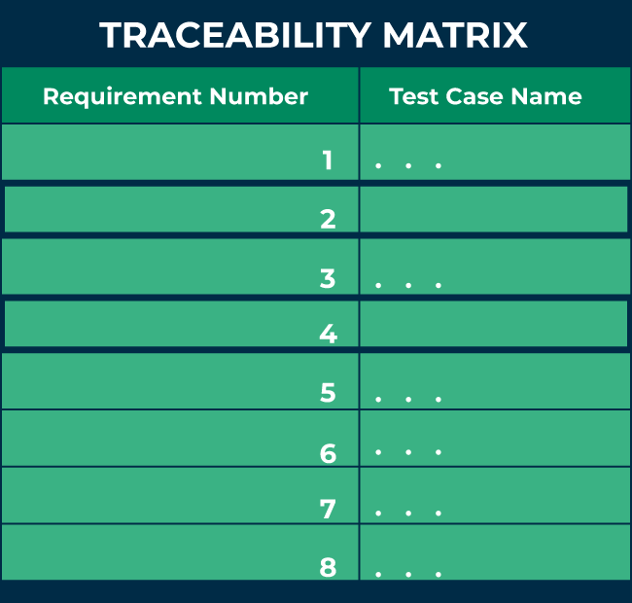
4. Traceability Matrix (3/3)

Slide 18
4. Traceability Matrix (3/3)
The main purpose of the requirement traceability matrix is to verify that the all requirements of clients are covered in the test cases designed by the testers.
Each test case is traced back to each requirement in the RTM. Therefore, there is less chance of missing any requirement in testing, and 100% test coverage can be achieved.

Slide 19
Why is a Traceability Matrix Important?
Helps in requirement verification by ensuring all requirements are covered.
Assists in impact analysis when making changes to the system.
Useful for audits and compliance tracking (e.g., HIPAA, GDPR, ISO standards).
Reduces risk by preventing missing or untested requirements.

Slide 20
Parameters of RTM
Requirement ID: The requirement ID is assigned to every requirement of the project.
Requirement description: for every requirement, a detailed description is given in the SRS (System/Software Requirement Specification) document.
Requirement Type: understand the type of requirements i.e., banking, telecom, healthcare, traveling, e-commerce, education, etc.
Test cases ID: the testing team designs test cases. Test cases are also assigned with some ID.

Slide 21
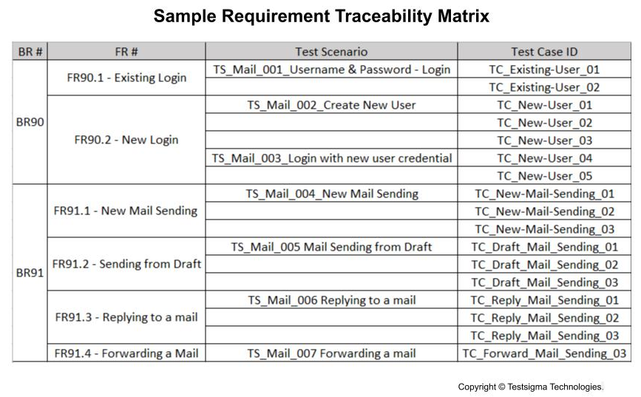

Slide 22
Types of Traceability Matrices
Forward Traceability – Ensures that all requirements are implemented in the final product.
Backward Traceability – Ensures that all design and development work is based on original requirements.
Bidirectional Traceability – Links requirements to test cases, ensuring full coverage both ways.

Slide 23
1. Forward Traceability
In the forward traceability matrix, requirements are mapped with the test cases.
Here we can verify that all requirements are covered in test cases and no functionality is missing in test cases.
It helps in ensuring that all the requirements available in the SRS/ Sprint backlog can be traced back to test cases designed by the testers.

Slide 24
2. Backward Traceability
In the backward traceability matrix, test cases are mapped with the requirements.
Here we can verify that no extra test case is added which is not required as per our requirements.
It helps you to ensure that any test cases that you have designed can be traced back to the requirements or user stories, and you are not extending the scope of the work (Scope Creep) by just creating additional test cases that can not be mapped to the requirement.
Also known as the “reverse traceability matrix”.

Slide 25
Bidirectional Traceability
A bi-directional traceability matrix is a combination of a forward traceability matrix and a backward traceability matrix.
Here we verify the requirements and test cases in both ways.

Slide 26
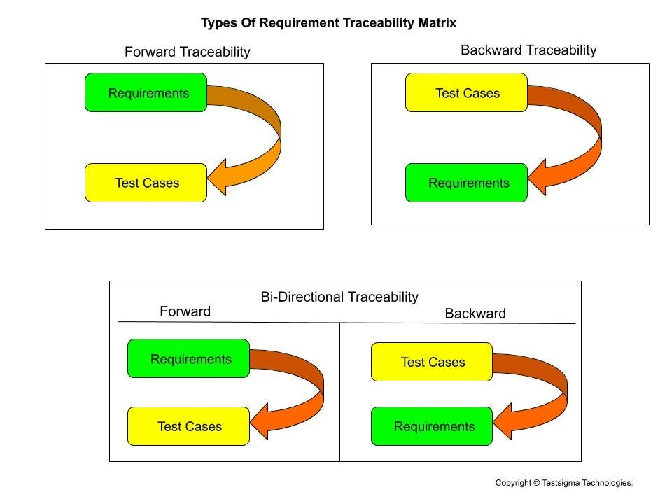

Slide 27
Structure of a Traceability Matrix
Requirement ID | Requirement Description | Design Specification | Test Case ID | Status
FR-001 | User Login | UI Wireframe V1 | TC-001 | Passed
FR-002 | Password Reset | Security Flow V2 | TC-002 | Pending
FR-003 | Fund Transfer | API Spec V3 | TC-003 | Failed

Slide 28
Example-1: Traceability Matrix for an Online Banking System
Requirement ID | Description | Linked Test Case | Status
FR-001 | User Login | TC-001 | Passed
FR-002 | Password Reset | TC-002 | Passed
FR-003 | Fund Transfer Between Accounts | TC-003 | Pending

Slide 29
Example-2: Traceability Matrix in a Healthcare System
Scenario: A hospital is developing an Electronic Medical Records (EMR) system that must comply with HIPAA regulations.
Use of Traceability Matrix:
Ensures that all patient data encryption requirements are implemented.
Tracks compliance-related requirements to specific test cases.
Provides an audit trail for external regulatory inspections.
Outcome: The traceability matrix helps verify that each HIPAA requirement is properly implemented and tested before deployment.

Slide 30
Benefits of Using a Traceability Matrix
Benefit | Explanation
Completeness | Ensures all requirements are implemented and tested.
Compliance Tracking | Helps in audits and meeting regulatory standards.
Change Management | Identifies impact when modifying system features.
Quality Assurance | Reduces defects by validating all requirements.

Slide 31
Challenges & Best Practices
Challenge: Keeping the matrix updated in fast-paced projects.
Solution: Automate traceability tracking using requirement management tools (e.g., JIRA, IBM DOORS).
Challenge: Managing a large number of requirements in complex systems.
Solution: Use hierarchical structuring for better organization.

Slide 32
Final One (RTM)
The Traceability Matrix is a critical tool in software development for requirement validation and compliance.
It ensures that all system components align with business needs and regulatory frameworks.
Best suited for regulated industries like healthcare, finance, and aerospace where compliance is essential.
A tool used to track the implementation of each requirement from design to deployment. Ensures all requirements are tested and validated.

Slide 33
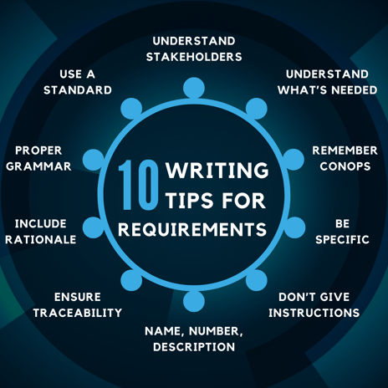
Guidelines for Writing Effective Requirements

Slide 34
Guidelines for Writing Effective Requirements
Understand Your Stakeholders
One of the key tips to writing great requirements is understanding your stakeholders.
By identifying and involving all relevant stakeholders from the beginning, you can ensure that their needs and expectations are captured in the requirements.
This collaborative approach leads to more comprehensive and accurate requirements.

Slide 35
Guidelines for Writing Effective Requirements
2. Understand What Is Needed
There is a huge difference between want and need.
One way to establish the difference is by asking yourself if the system will work without that requirement.
Rather than focusing on possible solutions, simply list what the system needs - the solution can come later.

Slide 36
Guidelines for Writing Effective Requirements
3. Remember the CONOPs
The Concept of Operations (CONOPS) is a valuable artifact. The CONOPS will be something that all the stakeholders understand and collaborate on together. Create different scenarios and needs. From there, you will better understand where to start with your requirements.
The CONOPS will help you write quality requirements by finding all the assumptions. It will help evaluate the ‘what if’ scenarios, make testing easier, and formulate your needs into the requirements.

Slide 37
Guidelines for Writing Effective Requirements
4. Be Specific, But Not Too Specific
Writing specific requirements is crucial to avoid ambiguity and misinterpretation. However, it is also important not to be overly specific, as this can limit flexibility and creativity in finding solutions.
Finding the right balance between specificity and flexibility is key to writing effective requirements.

Slide 38
Guidelines for Writing Effective Requirements
5. Give Requirements, Not Instructions
Understand what is needed and create requirements from those needs. This is why knowing your stakeholders is so important. If you understand your stakeholders' needs, writing requirements rather than instructions becomes an easier task.
Requirements should provide enough information to allow the builder to provide the most cost-effective solution to the problem.

Slide 39
Guidelines for Writing Effective Requirements
6. Include a Number, Name, and Description
Each requirement should be uniquely identified with a number and name for easy reference and tracking.
Additionally, a clear and concise description of the requirement is essential to ensure that all stakeholders have a common understanding of what is being requested.

Slide 40
Guidelines for Writing Effective Requirements
7. Ensure Traceability
Traceability is vital in requirements management to establish relationships between requirements, design, implementation, and testing. A requirement that refers to the name of another entity may be related to that entity with a “traced to”, “satisfied by”, or “verified by” relation, as appropriate.
By tracing requirements throughout the project lifecycle, you can ensure that each requirement is satisfied and verified, leading to a successful project outcome.

Slide 41
Guidelines for Writing Effective Requirements
8. Include a Rationale
A rationale (reason) justifies the inclusion of a specific requirement.
Attach a rationale for each requirement by explaining the need for the requirement.
The rationale provides reviewers and implementers with additional information on the intent of the requirements and avoids confusion down the line.

Slide 42
Guidelines for Writing Effective Requirements
9. Use Proper Grammar
Maintaining proper grammar in requirement documentation is crucial for clarity and consistency. Using proper grammar will prevent costly mistakes due to confusion.
Some grammar mistakes that can cause confusion are:
Run-on sentences result in two requirements appearing to be one.
Their, they’re, and there
Misspellings
To and Too

Slide 43
Guidelines for Writing Effective Requirements
10. Use a Standard
Use a standard to ensure consistency while writing your requirements, choosing one that is right for your industry.
Common standards are:
MIL-STD-490: The United States Military Standard establishes the format and content for the United States Department of Defense’s objectives. It can be useful in other areas as well.
IEEE: The Institute of Electrical and Electronics Engineers Standards Association develops the IEEE standards. Unlike the MIL-STDs, the IEEE reaches a broad range of industries, including transportation, healthcare, information technology, power, energy, and much more.
ISO: The International Organization for Standardization develops standards for businesses to optimize productivity and minimize costs.

Slide 44
Example: Applying the Tips in Practice
Imagine you are tasked with developing a new mobile application. A well-written requirement for this project could be:
Requirement Number: MA-001
Requirement Name: User Authentication
Description: The mobile application shall require users to log in using their email address and password to access personalized content.

Slide 45
Week Agenda
Introduction to Process Models
Traditional vs. Agile Requirements Engineering
Documenting Requirements
Quality Measurement in Requirements Engineering
Activity & Case Study

Slide 46
Quality Measurement in Requirements Engineering

